Slide 1

HTML and CSS Chapter 10: Creating Interactivity With CSS And JavaScript
In this chapter, You will learn how to use the CSS transform property to make elements move on a webpage. you will learn how to create an external JavaScript file and write several functions.

Slide 2
Introduction
Most modern websites include some form of interactivity. Interactivity is commonly integrated within a website using CSS and JavaScript, a web programming language used to enhance a website and create interactivity. An effective way to create interesting and useful webpages is to include dynamic content to make the webpage interactive.
One way to engage and interact with customers on a webpage is to use JavaScript code to display messages. In this chapter, you will explore how to integrate animation on a webpage using CSS and JavaScript. You will learn how to use the CSS transform property to make elements move on a webpage. You will also use CSS to create an animation using keyframes. Next, you will learn how to create an external JavaScript file and write several functions. Finally, you will learn how to reference the external JavaScript file within an HTML webpage.

Slide 3
Project — Add Interactivity to a Webpage
In Chapter 10, you learn how to use CSS to create interactivity and animations. This chapter also provides a basic introduction to JavaScript and discusses how to use JavaScript to enhance a webpage through interactivity.
The project in this chapter improves a website by adding interactivity to webpages using both CSS and JavaScript. To perform these tasks, you first use the CSS transform property to animate elements on a webpage. Next, you use CSS to create animation using keyframes. Then, you create a hamburger menu icon and use JavaScript code to make it functional. You also use JavaScript code to dynamically change a video on the About Us page. Finally, you use JavaScript code to dynamically change text within the Contact Us page. Figure 10–1 shows the home page with the CSS transform property applied. Figure 10–2 shows a still of the animation on the home page. Figure 10–3 shows the hamburger menu icon as displayed in a mobile viewport. Figure 10–4 shows the video displayed as a result of a JavaScript function.

Slide 4
Roadmap
In this chapter, you will learn how to create the webpages shown in Figures 10–1, 10–2, 10–3, and 10–4. The following roadmap identifies general activities you will perform as you progress through this chapter:
create css transform.
create css animation.
create a hamburger menu.
create a javascript file.
create and call javascript functions.

Slide 5
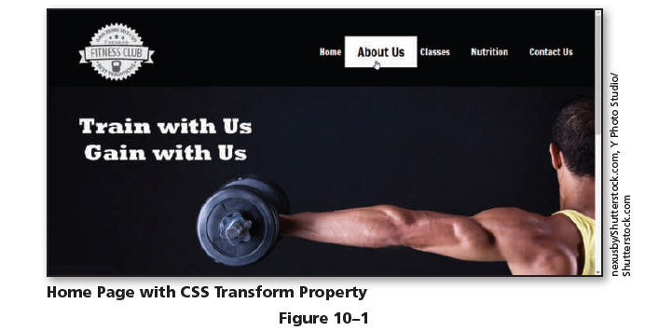
Roadmap

Slide 6
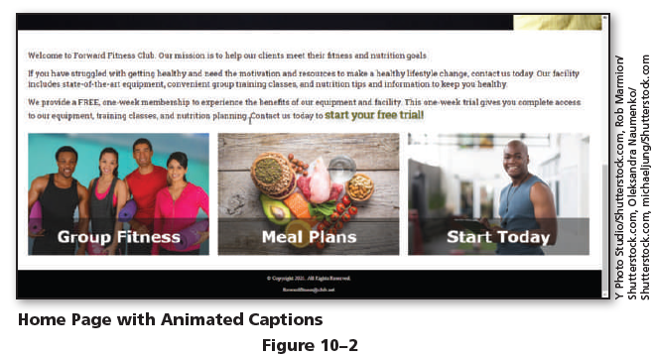
Roadmap

Slide 7
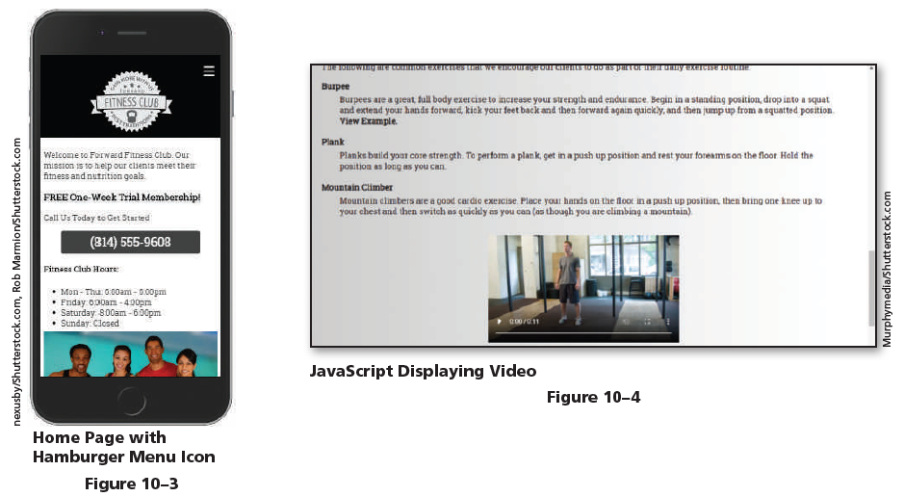
Roadmap

Slide 8
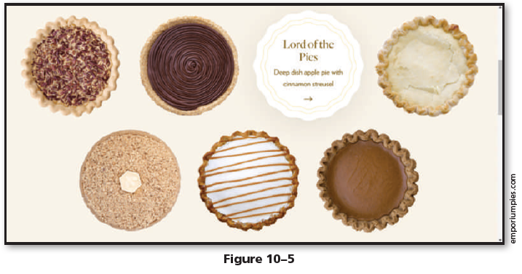
Using CSS to Create Interactivity
CSS began as a simple way to add color and design a webpage, but today, it has evolved to become so much more. CSS can be used to move elements on a webpage, change the color of an element, or change the appearance of an element. To see a demonstration of how CSS is used to create interactivity, open your browser to emporiumpies.com/pies, which is shown in Figure 10–5.

Slide 9
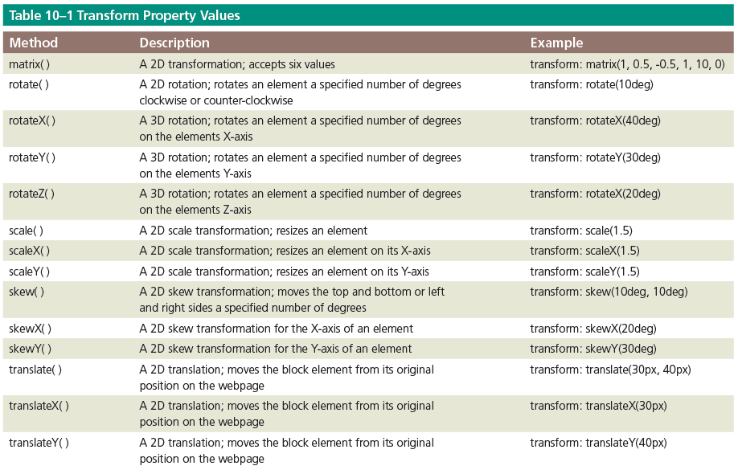
Using CSS to Create Interactivity
This page uses the CSS transform property to rotate the pies 180 degrees in 3D. The transform property allows block elements to be transformed or changed within two-dimensional or three-dimensional space. You can use a transform to rotate, scale, skew, or translate a block element. Table 10–1 lists the methods that can be used with the transform property.

Slide 10
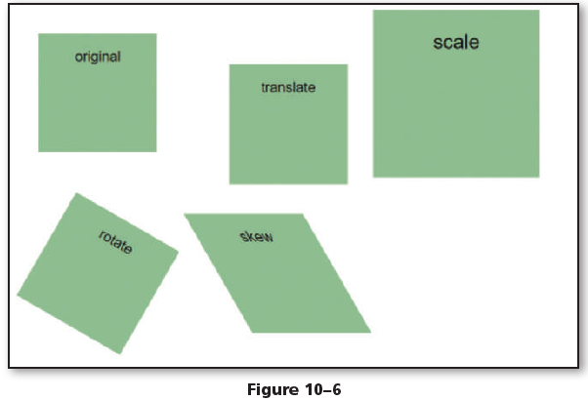
Using CSS to Create Interactivity
Figure 10–6 shows an example of several transforms.
As Figure 10–6 demonstrates, the translate method moves the element from its original position. The scale method increases the size of the original element. The rotate method rotates the element 30 degrees clockwise. The skew method skews the sides of the element.

Slide 11
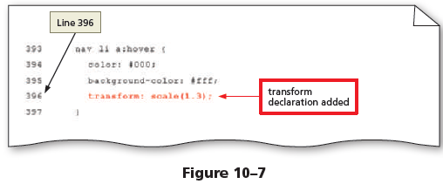
To Apply a CSS Transform to a Webpage
Apply a transform scale method to the navigation links for a desktop viewport and apply a translate method to the figure elements on the home page. Why? Applying a transform to a website adds interactivity to a webpage and improves the user experience. The following steps add the transform property to the style sheet.
1
Open styles.css in your text editor and update the comment with today’s date.
Scroll down to the desktop media query and locate the style rule for nav li a:hover on Line 393.
Tap or click at the end of Line 395, press the enter key to insert a new Line 396, and then type transform: scale(1.3); to insert a new declaration.
Save your changes (Figure 10–7).

Slide 12
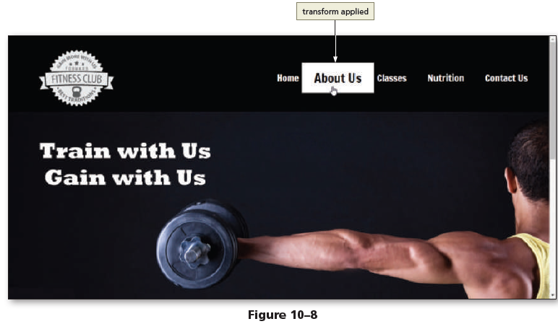
To Apply a CSS Transform to a Webpage
Open index.html in your browser, adjust the window to the size of a desktop viewport, and then hover over the navigation links to view the transform effect (Figure 10–8).

Slide 13
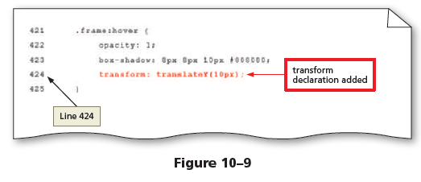
To Apply a CSS Transform to a Webpage
Return to styles.css in your text editor.
Tap or click at the end of Line 423, press the enter key to insert a new Line 424, and then type transform: translateY(10px); to insert a new declaration.
Save your changes (Figure 10–9).

Slide 14
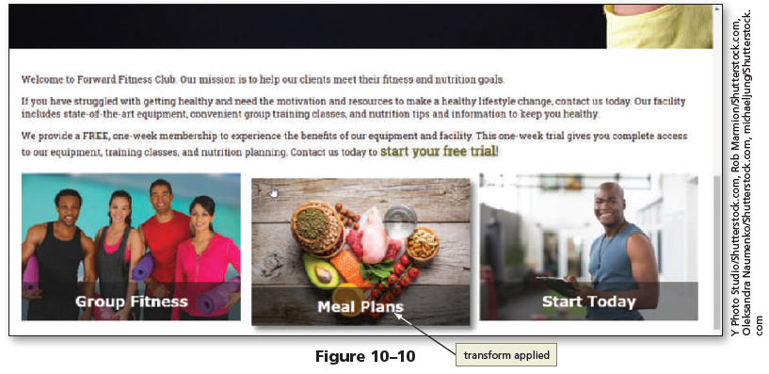
To Apply a CSS Transform to a Webpage
Refresh index.html in your browser, and then hover over the images in the main content area to view the transform effect (Figure 10–10).

Slide 15
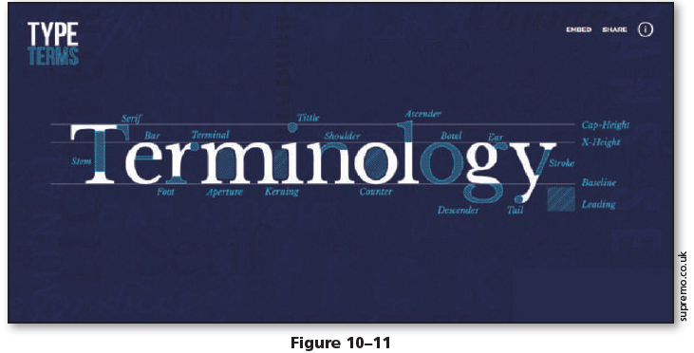
To Apply a CSS Transform to a Webpage
You can add interactivity to a webpage in other ways. CSS also provides a method to create animations on a webpage. Animations allow you to move elements on a page or change their appearance. To see a demonstration of how CSS is used to create animation, open your browser to supremo.co.uk/typeterms/. This page is shown in Figure 10–11.

Slide 16
To Apply a CSS Transform to a Webpage
When you tap or click a type term, CSS animation is used to move elements and display new content. To add an animation with CSS, you create it with an @keyframes rule. The @keyframes rule specifies the name of the animation as well as the animation parameters. The following is an example of an @keyframes rule.
@keyframes my-animation {
0% { opacity: 0; }
100% { opacity: 1; }
}
In the example above, my-animation is the name of the animation. When the animation begins, at 0%, the opacity is set to 0. When the animation ends, at 100%, the opacity is set to 1. Older versions of the Apple Safari browser require the prefix @-webkit- before keyframes. For browser compatibility, create two @keyframes rules; the first with the @-webkit- prefix, and the second without the prefix. Refer to the following example.
@-webkit-keyframes my-animation {
0% { opacity: 0; }
100% { opacity: 1; }
}
@keyframes my-animation {
0% { opacity: 0; }
100% { opacity: 1; }
}

Slide 17
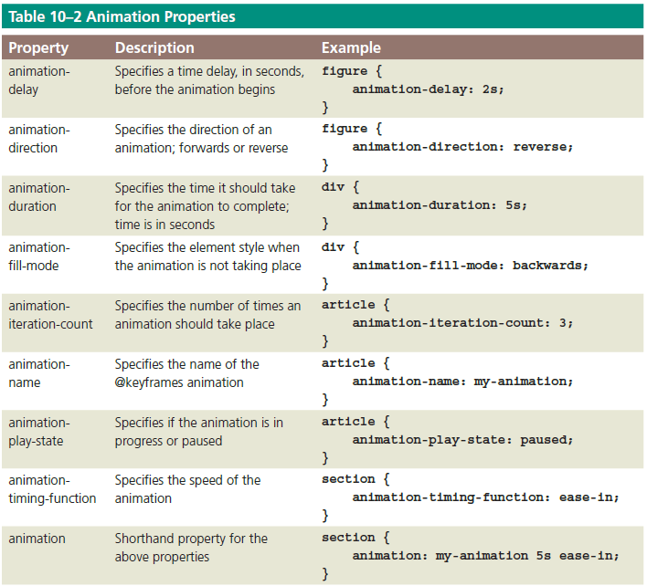
To Apply a CSS Transform to a Webpage
After creating the animation, you can apply it to an existing style rule or create a new style rule. Tab le 10–2 lists the various animation properties that can be used to apply an animation.

Slide 18
To Apply a CSS Transform to a Webpage
To apply the my-animation to an element, add new declarations to an existing style rule or create a new style rule. Include a declaration that uses the -webkit- prefix for browser compatibility. For example, if you want to apply the my-animation to a figure element, create the following style rule:
figure {
-webkit-animation-duration: 5s;
animation-duration: 5s;
-webkit-animation-name: my-animation;
animation-name: my-animation;
}
In this style rule, the my-animation is applied to the figure element with a duration of five seconds.a

Slide 19
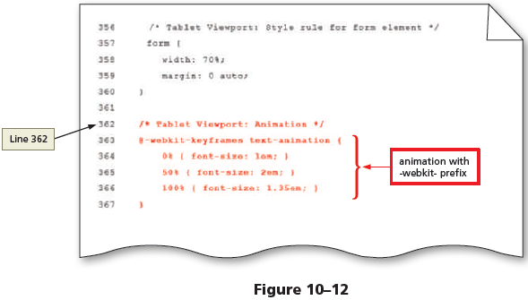
To Add Animation to a Webpage
Use CSS to create an animation and then apply the animation to elements on the home page. Why? Adding animation to a webpage grabs the user’s attention and improves the user experience. The following steps add an animation to the style sheet.
1
Return to styles.css in your text editor, tap or click at the end of Line 360 and press the enter key twice to insert new Lines 361 and 362.
On Line 362, type /* Tablet Viewport: Animation */ to insert a new comment.

Slide 20
To Add Animation to a Webpage
Press the enter key to insert a new Line 363, and then type @-webkit-keyframes text-animation { to create a new @keyframes rule with the webkit prefix.
Press the enter key to insert a new Line 364, increase the indent, and then type 0% { font-size: 1em; } to specify the start of the animation.
Press the enter key to insert a new Line 365, and then type 50% { font-size: 2em; } to specify the middle of the animation.
Press the enter key to insert a new Line 366, and then type 100% { font-size: 1.35em; } to specify the end of the animation.
Press the enter key to insert a new Line 367, decrease the indent, and then type } to close the animation (Figure 10–12).

Slide 21
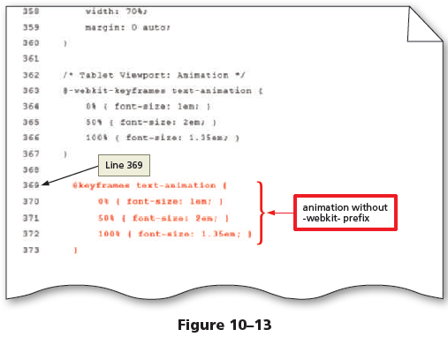
To Add Animation to a Webpage
Press the enter key twice to insert new Lines 368 and 369, and then type @keyframes text-animation { to create a new @keyframes rule.
Press the enter key to insert a new Line 370, increase the indent, and then type 0% { font-size: 1em; } to specify the start of the animation.
Press the enter key to insert a new Line 371, and then type 50% { font-size: 2em; } to specify the middle of the animation.
Press the enter key to insert a new Line 372, and then type 100% { font-size: 1.35em; } to specify the end of the animation.
Press the enter key to insert a new Line 373, decrease the indent, and then type } to close the animation (Figure 10–13).

Slide 22
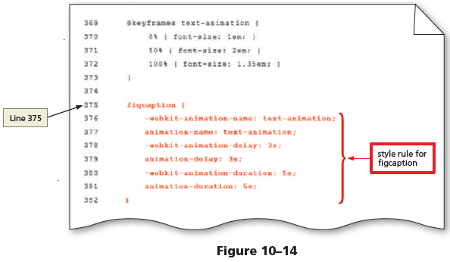
To Add Animation to a Webpage
Press the enter key twice to insert new Lines 374 and 375, and then type figcaption { to add a new selector.
Press the enter key to insert a new Line 376, increase the indent, and then type -webkit-animation-name: text-animation; to add a new declaration.
Press the enter key to insert a new Line 377, and then type animation-name: text-animation; to add a new declaration.
Press the enter key to insert a new Line 378, and then type -webkit-animation-delay: 3s; to add a new declaration.

Slide 23
To Add Animation to a Webpage
Press the enter key to insert a new Line 379, and then type animation-delay: 3s; to add a new declaration.
Press the enter key to insert a new Line 380, and then type -webkit-animation-duration: 5s; to add a new declaration.
Press the enter key to insert a new Line 381, and then type animation-duration: 5s; to add a new declaration.
Press the enter key to insert a new Line 382, decrease the indent, and then type } to close the animation (Figure 10–14).

Slide 24
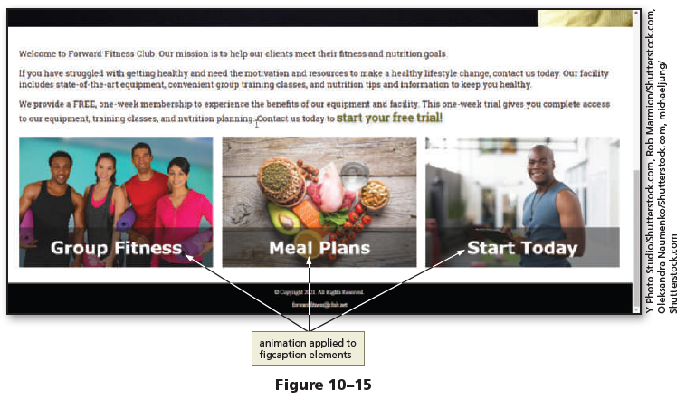
To Add Animation to a Webpage
Save your changes.
Refresh index.html in your browser, scroll down the page to view the figure and figcaption elements, and then wait three seconds for the animation to begin (Figure 10–15).

Slide 25
Incorporating JavaScript
JavaScript is scripting language used to provide various types of functionality to webpages, such as the ability to interact with the user. In a web environment, web developers use a scripting language to control webpages. This includes providing user feedback, validating form data, and creating dynamic content based on user actions. JavaScript is a client-side scripting language, which means that the browser (i.e., the client) interprets and renders the JavaScript.
JavaScript was developed in the 1990s by Brendan Eich at Netscape and was originally known as Mocha and then LiveScript. During this same period, the Sun Microsystems Java technology was gaining in popularity. A marketing deal was struck with Sun Microsystems to adopt the Java name and change LiveScript to JavaScript. However, JavaScript and Java are not the same. Java is a more complex programming language, commonly used to create large business applications and native mobile applications for the Android operating system.

Slide 26
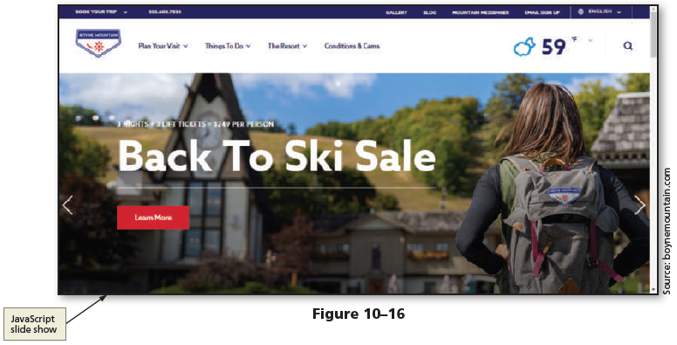
Incorporating JavaScript
Most modern websites use some form of JavaScript within their website. JavaScript provides additional interactivity between the webpage and the user. Developers can use JavaScript to validate form information, send an alert to a user, change HTML content, show or hide content, animate elements, and much more. Efficient use of JavaScript can significantly improve and enrich the user experience. Figure 10–16 demonstrates how JavaScript is used to create a slide show on the home page for Boyne Mountain Resort.

Slide 27
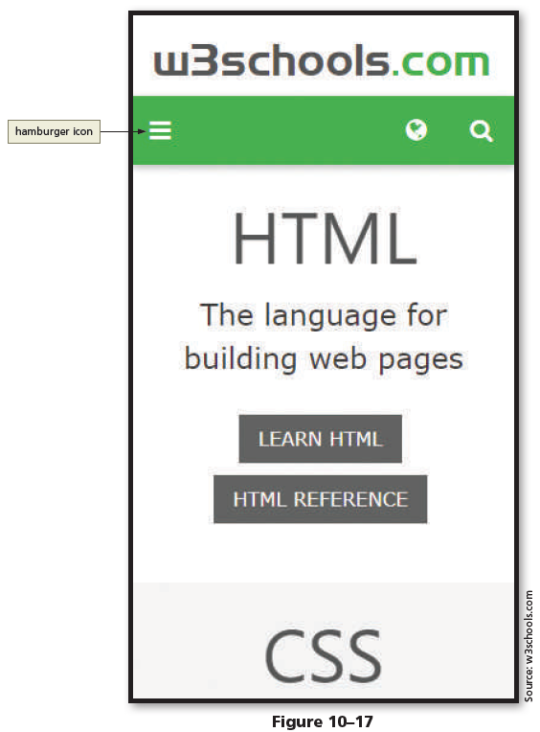
Incorporating JavaScript
Many mobile websites integrate an icon commonly known as the hamburger icon for use as a menu button. The hamburger icon consists of three horizontal, parallel lines, as shown in Figure 10–17, and uses JavaScript to display a menu and allow users to select an option.

Slide 28
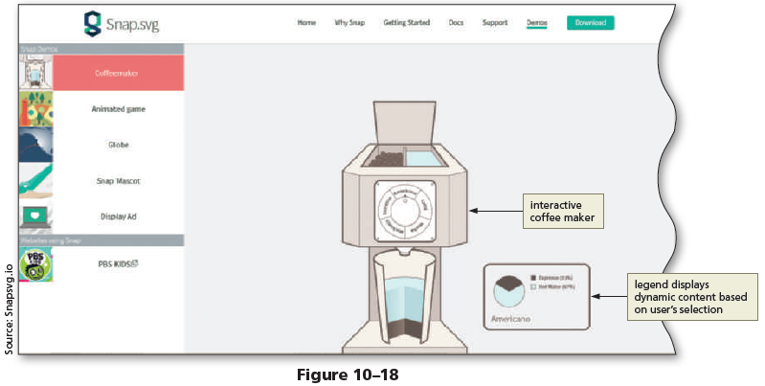
Incorporating JavaScript
Figure 10–18 shows how JavaScript is used on the Snap.svg demo page. Users select the type of coffee to make and then watch the animation of the coffee maker.
The legend next to the coffee maker lets the user know the ingredients and amounts.

Slide 29
Incorporating JavaScript
You can integrate JavaScript into webpages in many ways. You must first determine the types of interactivity you want to provide into your website and then determine whether JavaScript is the best approach to accomplish the interactivity.
You will replace the current navigation bar used for the mobile viewport of the Forward Fitness Club website with a hamburger menu. The following steps create the hamburger menu icon on all of the webpages for the Forward Fitness Club website.
Later, you will use JavaScript to make the hamburger functional.

Slide 30
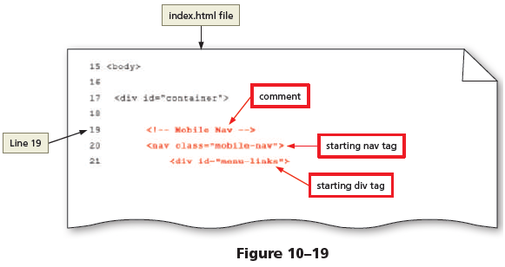
To Create a New Nav Element for a Mobile Viewport
Add a new nav element to the HTML webpages. Why? The new nav element will be used to display a hamburger menu for a mobile viewport. To create a hamburger menu, begin by adding a new nav element to the index.html file. The following steps add a new nav element to all of the HTML webpages.
1
Open the index.html file in your text editor to prepare to edit the file.
Tap or click at the end of Line 17, and then press the enter key twice to insert new Lines 18 and 19.
On Line 19, type <!-- Mobile Nav --> to insert a new comment.
Press the enter key to insert a new Line 20, and then type <nav class="mobile-nav"> to insert a starting nav tag.
Press the enter key to insert a new Line 21, increase the indent, and then type <div id="menu-links"> to insert a starting div tag (Figure 10–19).

Slide 31
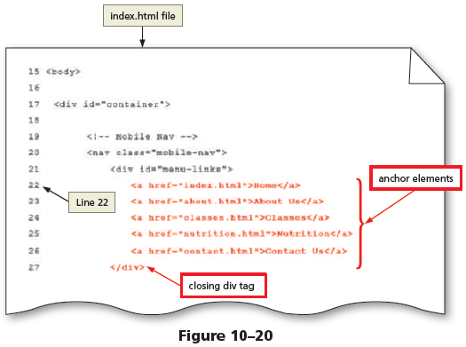
To Create a New Nav Element for a Mobile Viewport
Press the enter key to insert a new Line 22, increase the indent, and then type <a href="index. html">Home</a> to insert an anchor element.
Press the enter key to insert a new Line 23, and then type <a href="about.html">About Us</a> to insert an anchor element.
Press the enter key to insert a new Line 24, and then type <a href="classes.html">Classes</a> to insert an anchor element.
Press the enter key to insert a new Line 25, and then type <a href="nutrition.html">Nutrition</a> to insert an anchor element.
Press the enter key to insert a new Line 26, and then type <a href="contact.html">Contact Us</a> to insert an anchor element.
Press the enter key to insert a new Line 27, decrease the indent, and then type </div> to insert a closing div tag (Figure 10–20).

Slide 32
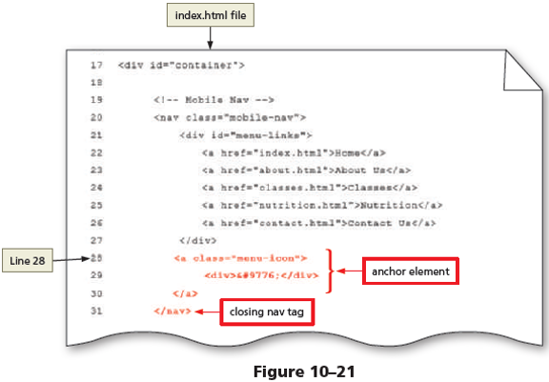
To Create a New Nav Element for a Mobile Viewport
Press the enter key to insert a new Line 28, and then type <a class="menu-icon"> to insert a starting anchor tag.
Press the enter key to insert a new Line 29, increase the indent, and then type <div>&#9776;</div> to insert a new div element.
Press the enter key to insert a new Line 30, decrease the indent, and then type </a> to insert a closing anchor tag.
Press the enter key to insert a new Line 31, decrease the indent, and then type </nav> to insert a closing nav tag (Figure 10–21).

Slide 33
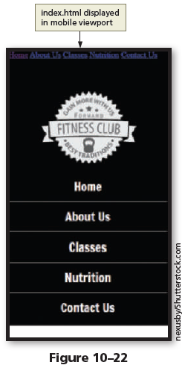
To Create a New Nav Element for a Mobile Viewport
Save your changes.
Open the index.html file in Google Chrome’s device mode, and then tap or click the Mobile – S 320px (gray) bar to view the page in a mobile viewport (Figure 10–22).

Slide 34
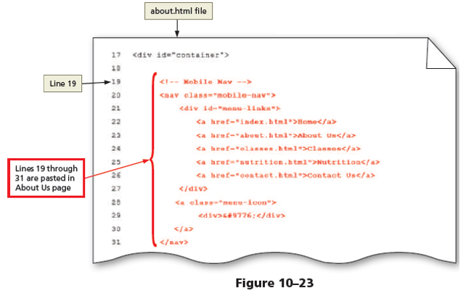
To Create a New Nav Element for a Mobile Viewport
Select Lines 19 through 31 and then press ctrl+c to copy these lines of code.
Open the about.html file in your text editor, tap or click at the end of Line 17, and then press the enter key twice to insert new Lines 18 and 19.
On Line 19, press ctrl+v to paste the lines of code (Figure 10–23).

Slide 35
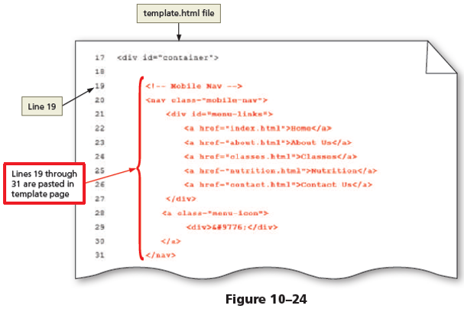
To Create a New Nav Element for a Mobile Viewport
Open the classes.html file in your text editor, tap or click at the end of Line 17, and then press the enter key twice to insert new Lines 18 and 19.
On Line 19, press ctrl+v to paste the lines of code.
Open the nutrition.html file in your text editor, tap or click at the end of Line 17, and then press the enter key twice to insert new Lines 18 and 19.
On Line 19, press ctrl+v to paste the lines of code.

Slide 36
To Create a New Nav Element for a Mobile Viewport
Open the contact.html file in your text editor, tap or click at the end of Line 17, and then press the enter key twice to insert new Lines 18 and 19.
On Line 19, press ctrl+v to paste the lines of code.
Open the template.html file in your text editor, tap or click at the end of Line 17, and then press the enter key twice to insert new Lines 18 and 19.
On Line 19, press ctrl+v to paste the lines of code (Figure 10–24).

Slide 37
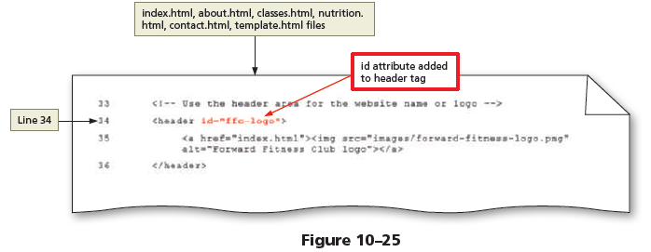
To Create a New Nav Element for a Mobile Viewport
Return to the index.html file in your text editor to prepare to modify the file.
On Line 34, within the header tag, type id="ffc-logo" to add an id attribute.
Add the same id attribute to the header tag for the about.html, classes.html, nutrition.html, contact.html, and template.html files (Figure 10–25).

Slide 38
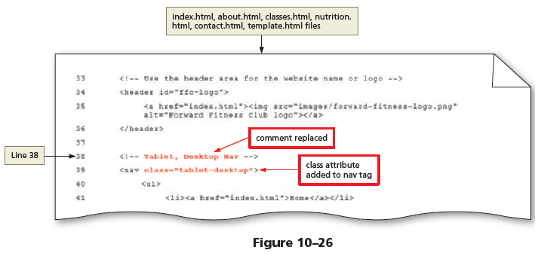
To Create a New Nav Element for a Mobile Viewport
Return to the index.html file in your text editor to prepare to modify the file.
On Line 38, replace the existing comment with the text Tablet, Desktop Nav to modify the comment.
On Line 39, within the nav tag, type class="tablet-desktop" to add a class attribute.
Replace the same comment and add the same class attribute to the nav tag on Line 39 for the about.html, classes. html, nutrition.html, contact.html, and template.html files (Figure 10–26).

Slide 39
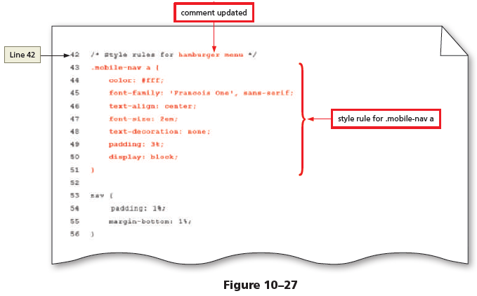
To Style the New Nav Element for a Mobile Viewport
Now that you have added the hamburger icon, style it for a mobile viewport. Why? Show the hamburger icon and hide the new nav links. You will use JavaScript in future steps to toggle the links to be displayed. Create a style rule for the menu-links id to format the appearance of the navigation links when displayed. Create a style rule to format the appearance and the position of the hamburger icon. The following steps create new style rules for a mobile viewport in the styles.css file.
1
If necessary, reopen the styles.css file in your text editor to prepare to edit the file.
On Line 42, replace the text, navigation area, with hamburger menu.
Tap or click at the end of Line 42, and then press the enter key to insert a new Line 43.
On Line 43, type .mobile-nav a { to add a new selector.

Slide 40
To Style the New Nav Element for a Mobile Viewport
Press the enter key to insert a new Line 44, increase the indent, and then type color: #fff; to insert a new declaration.
Press the enter key to insert a new Line 45, and then type font-family: 'Francois One', sans-serif; to insert a new declaration.
Press the enter key to insert a new Line 46, and then type text-align: center; to insert a new declaration.
Press the enter key to insert a new Line 47, and then type font-size: 2em; to insert a new declaration.

Slide 41
To Style the New Nav Element for a Mobile Viewport
Press the enter key to insert a new Line 48, and then type text-decoration: none; to insert a new declaration.
Press the enter key to insert a new Line 49, and then type padding: 3%; to insert a new declaration.
Press the enter key to insert a new Line 50, and then type display: block; to insert a new declaration.
Press the enter key to insert a new Line 51, decrease the indent, and then type } to close the style rule.
Press the enter key to insert a new, blank Line 52 (Figure 10–27).

Slide 42
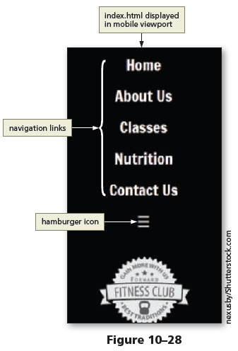
To Style the New Nav Element for a Mobile Viewport
Save your changes.
Open the index.html file in Google Chrome’s device mode and, if necessary, tap or click the Mobile – S 320px (gray) bar to view the page in a mobile viewport (Figure 10–28).

Slide 43
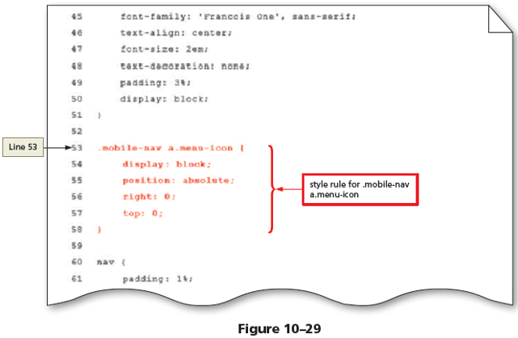
To Style the New Nav Element for a Mobile Viewport
Tap or click at the end of Line 51, and then press the enter key twice to insert new Lines 52 and 53.
On Line 53, type .mobile-nav a.menu-icon { to add a new selector.
Press the enter key to insert a new Line 54, increase the indent, and then type display: block; to insert a new declaration.
Press the enter key to insert a new Line 55, and then type position: absolute; to insert a new declaration.

Slide 44
To Style the New Nav Element for a Mobile Viewport
Press the enter key to insert a new Line 56, and then type right: 0; to insert a new declaration.
Press the enter key to insert a new Line 57, and then type top: 0; to insert a new declaration.
Press the enter key to insert a new Line 58, decrease the indent, and then type } to close the style rule (Figure 10–29).

Slide 45
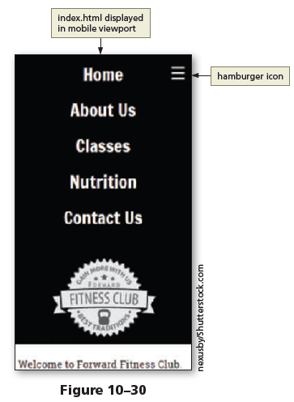
To Style the New Nav Element for a Mobile Viewport
Save your changes.
Refresh the index.html file in Google Chrome’s device mode to view the changes (Figure 10–30).

Slide 46
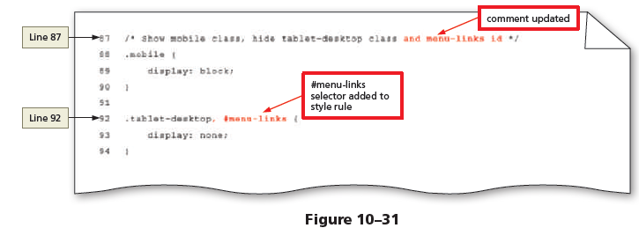
To Style the New Nav Element for a Mobile Viewport
Locate the comment on Line 87.
Add the text and menu-links id to the end of the comment to modify the comment.
Locate the style rule for the .tablet-desktop class on Line 92.
Place the insertion point after .tablet-desktop and then type , #menu-links to add a new selector to this style rule (Figure 10–31).

Slide 47
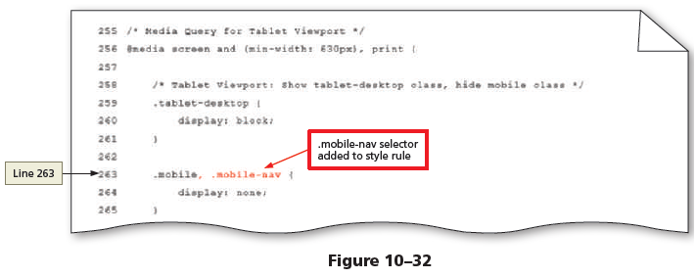
To Style the New Nav Element for a Mobile Viewport
Locate the style rule for the .mobile class on Line 263, located within the tablet media query.
Place the insertion point after .mobile and then type , .mobile-nav to add a new selector to this style rule (Figure 10–32).

Slide 48
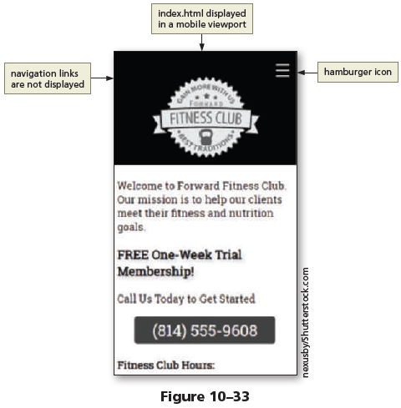
To Style the New Nav Element for a Mobile Viewport
Save your changes.
Refresh the index.html file in Google Chrome’s device mode to view the changes (Figure 10–33).

Slide 49
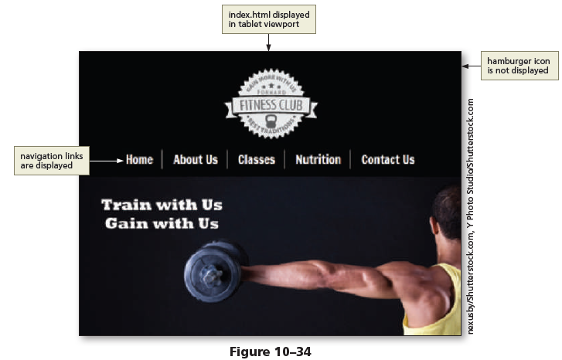
To Style the New Nav Element for a Mobile Viewport
Switch to a tablet viewport to display the tablet navigation (Figure 10–34).

Slide 50
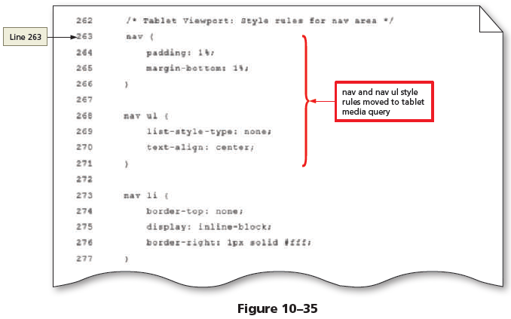
To Modify Previous Navigation Style Rules for a Mobile Viewport
You have finished styling the hamburger menu and navigation links but need to do some housekeeping regarding the previous style rules created for the navigation links for the mobile viewport. Why? As a developer, you should always keep your code clean and remove unnecessary code. Move the mobile style rules for the nav, nav ul, and nav li a to the tablet media query. Move two declarations from the nav li for mobile to the nav li style rule for tablet. Remove the nav li and nav li:first-child style rules for mobile. The following steps modify style rulesfor mobile and tablet viewports in the styles.css file.
1
If necessary, reopen the styles.css file in your text editor to prepare to edit the file.
Select the nav and nav ul style rules on Lines 60 through 68, and then press ctrl+x to cut these style rules.
If necessary, move the nav li style rule up to Line 60.

Slide 51
To Modify Previous Navigation Style Rules for a Mobile Viewport
Locate the comment, Tablet Viewport: Style rules for nav area, located within the tablet media query on Line 262.
Tap or click at the end of Line 262, and then press the enter key to insert a new Line 263.
On Line 263, press ctrl+v to paste the style rules. If necessary, indent the style rules.
Tap or click at the end of Line 271, and then press the enter key to insert a new, blank Line 272, if necessary (Figure 10–35).

Slide 52
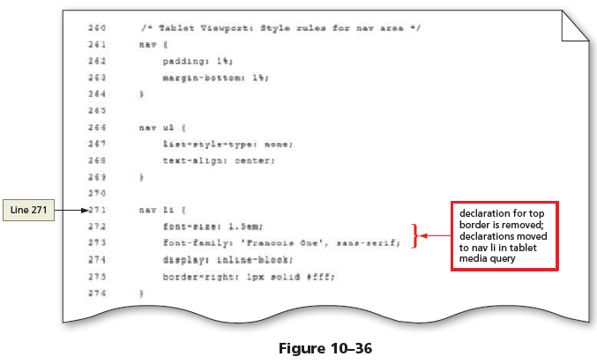
To Modify Previous Navigation Style Rules for a Mobile Viewport
Locate the nav li style rule above the tablet media query on Line 60.
Select the font-size: 1.5em; and font-family: 'Francois One', sans-serif; on Lines 61 through 62 and then press ctrl+x to cut these style rules.
If necessary, move the border-top declaration up to Line 61.
Scroll down to the tablet media query and locate the nav li style rule that begins on Line 271.
Select the border-top: none; declaration on Line 272, and then press ctrl+v to replace the declaration with the copied declarations. If necessary, indent the declarations (Figure 10–36).

Slide 53
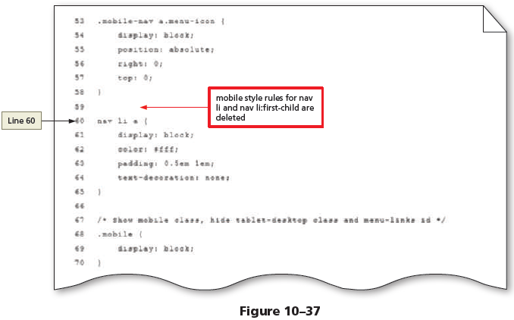
To Modify Previous Navigation Style Rules for a Mobile Viewport
Scroll back up to the mobile nav li style rule, select Lines 60 through 66, and then press the delete key to remove the nav li and the nav li:first-child style rules.
If necessary, move the nav li a style rule up to Line 60 (Figure 10–37).

Slide 54
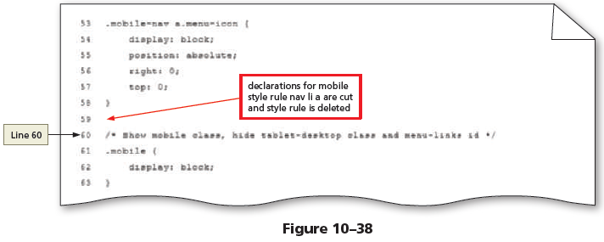
To Modify Previous Navigation Style Rules for a Mobile Viewport
Select Line 63, and then press the delete key to remove the padding declaration.
If necessary, move the text-decoration declaration up to Line 63.
Select Lines 61 through 63, and then press the ctrl+x keys to cut the three declarations out of the nav li a style rule.
Select Lines 60 through 62, and then press the delete key to remove the nav li a style rule.
If necessary, move the Show mobile class comment up to Line 60 (Figure 10–38).

Slide 55
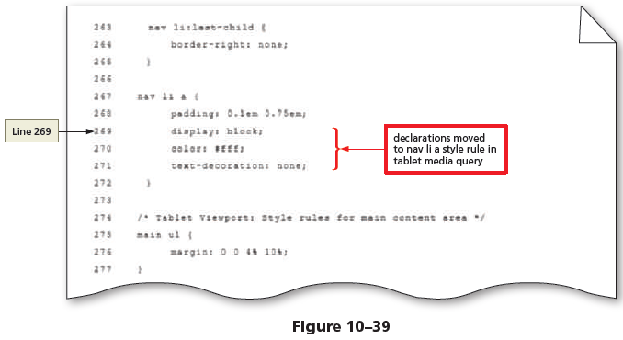
To Modify Previous Navigation Style Rules for a Mobile Viewport
Scroll down to the tablet media query and locate the nav li a style rule that begins on Line 267.
Tap or click at the end of Line 268, press the enter key to insert a new Line 269, and then press the ctrl+v keys to paste the three declarations within the nav li a style rule.
If necessary, indent the declarations (Figure 10–39).

Slide 56
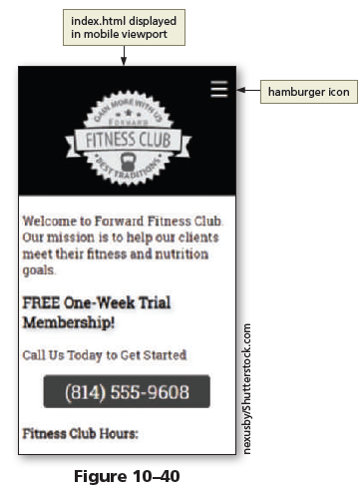
To Modify Previous Navigation Style Rules for a Mobile Viewport
Save your changes.
Refresh the index.html file in Google Chrome’s device mode and select the mobile viewport to view the hamburger menu icon (Figure 10–40).

Slide 57
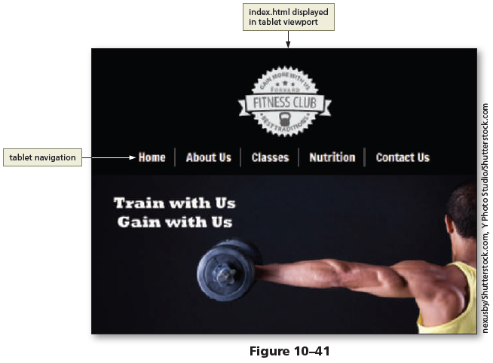
To Modify Previous Navigation Style Rules for a Mobile Viewport
Switch to a tablet viewport to display the tablet navigation (Figure 10–41).

Slide 58
JavaScript Terminology
To use JavaScript effectively, you should be familiar with its basic terminology, including statements, objects, properties, methods, arguments, functions, and variables. A JavaScript statement is a line of programming instructions to be executed by the client (the browser). JavaScript statements end with a semicolon. The following is an example of a JavaScript statement:
document.write("Good Morning");
An object in JavaScript is anything that can be treated as its own entity. Examples of objects include a document (the webpage), an HTML element, or webpage content. Developers can also create objects. For example, a developer might create an array object, used to hold customer information, such as first name, last name, address, and email address. Properties can be assigned to JavaScript objects. Properties are attributes that describe an object’s characteristics. As shown in the following example, an object name and its property are separated by a period.
video.style.display = "block";
In this example, the video object is stated first followed by a period, followed by the style property, which indicates a style is to be applied. After the style property, another period is inserted, followed by the display property. In this example, the video’s display property is set to block. A value can be assigned to the property, or the property can return a value. The equal sign in this example is an assignment operator. It assigns a value to the video’s display property.

Slide 59
JavaScript Terminology
Methods are actions that an object can perform. For example, methods associated with the document object might be write and open. An object and one of its methods would be written as follows:
document.write();
In this code, document is the object and write is a method of the document object. Methods are followed by parentheses, which may be empty, or may contain an argument.
An argument or parameter is a value given to a method. Some methods require arguments, and others do not. For example, given a document object and the write() method, include the argument "Good Morning" to describe the content to display for the document as follows:
document.write("Good Morning");
In this case, the argument "Good Morning" describes the text content to display on the document.

Slide 60
JavaScript Terminology
A function is a set of JavaScript statements that perform a specific task. For example, you could create a function that calculates the sales tax for items purchased. A function must include a name and statements that specify a task to be performed.
Following is an example of a function.
function myFunction() {
statement 1;
statement 2;
statement 3;
}

Slide 61
JavaScript Terminology
A variable is a container that holds a value. JavaScript uses variables to store values temporarily in internal memory. A variable’s value can change, depending on the results of an expression or data entered by a user in a form. Variables must have a unique name and must follow the same naming conventions as user-defined functions.
The following is an example of a variable.
var promo = "Save today with promo code SAVE25";
When defining a variable, begin with the keyword var, followed by the variable name. In this example, promo is the variable name. The equal sign assigns this variable a text string, Save today with promo code SAVE25.
Variables can be defined locally or globally. Local variables are created within a function. These variables can only be used by the function in which they are defined.
Global variables are created outside of a function. They are typically defined near the top of an external JavaScript file. Global variables may be used by any function within the JavaScript file.

Slide 62
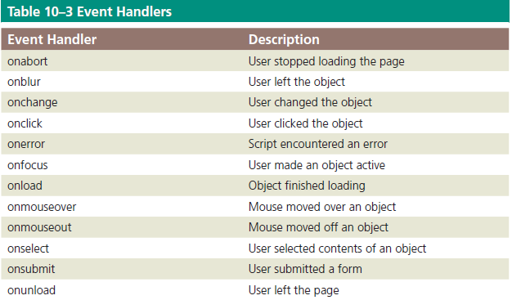
JavaScript Terminology
Most JavaScript user-defined functions are called or invoked using event handlers.
An event is the result of an action, such as a mouse click or a webpage loading into the browser. An event handler is how JavaScript associates an action with a function.
JavaScript event handlers make webpages more dynamic and interactive by allowing JavaScript code to execute only in response to a user action, such as a mouse click.
Table 10–3 lists common event handlers.

Slide 63
Writing JavaScript Code
Keep the following syntax rules and guidelines in mind when writing JavaScript code. First, JavaScript is case sensitive, which means that it distinguishes between upper- and lowercase letters. If you create a variable named foodGroup, JavaScript will not recognize this variable if it is written as FoodGroup.
Like HTML and CSS, you can incorporate comments in JavaScript code.
Use two slashes for a one-line comment and use the slash and asterisk for multiline comments, as follows:\
// Single line comment syntax
/* Multiple line
comment syntax */

Slide 64
Writing JavaScript Code
Using semicolons to end JavaScript statements is a common practice by programmers. Although it is not always necessary, it is a good best practice. The only time the semicolon is necessary is when multiple statements appear on the same line.
The semicolon is used to separate each statement, similar to how a period separates one sentence from another. The following statements are all valid:
foodOne = squash
foodTwo = pepper;
foodOne = squash; foodTwo = pepper;

Slide 65
Writing JavaScript Code
You can write JavaScript within a script element on an HTML page or as a separate JavaScript file with the filename extension .js. When JavaScript is written within an HTML page, the code may be within the head element or the body element, depending upon the developer and the task at hand. The following is an example of how to write a JavaScript statement within an HTML document using the script tags.
<script>
JavaScript statements;
</script>

Slide 66
Writing JavaScript Code
Using an external JavaScript file is a best practice. When you create JavaScript as an external .js file, you reference the file using a script element. If the JavaScript file is needed during the page loading time, place the script element within the head element of the HTML document. If the JavaScript file is not needed for page loading, place the script element above the closing body tag on the HTML file. Specify the external .js file as the file source, as shown in the following example:
<script src="scripts/myscripts.js"></script>

Slide 67
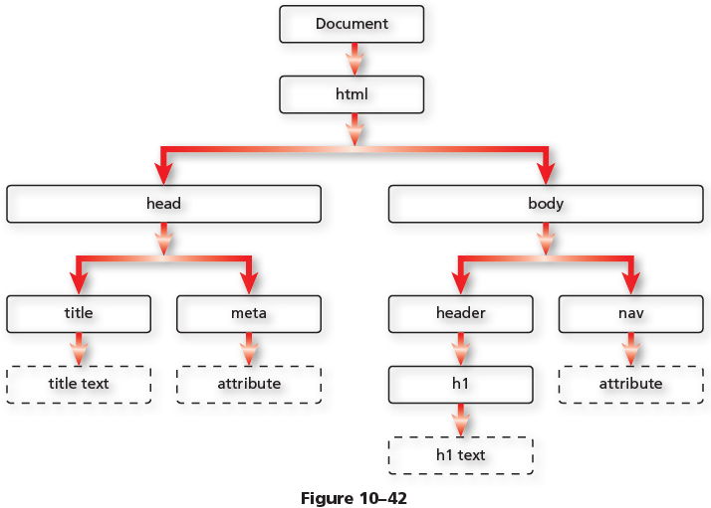
DOM Methods
DOM stands for Document Object Model. Recall that every element on an HTML page is an object. The HTML DOM consists of all the HTML elements, attributes, and text. Together, all of these items are objects on the page. Figure 10–42 shows an example of an HTML DOM tree.

Slide 68
DOM Methods
Each item in the DOM tree is also known as a node. Any of these objects can be accessed using JavaScript DOM methods. Using a DOM method, you can use JavaScript to manipulate an HTML element. One common DOM method is getElementById( ). The following provides an example of the getElementById( ) method:
var logo = document.getElementById("ffc-logo");

Slide 69
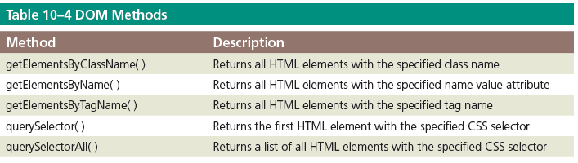
DOM Methods
In this statement, the logo variable is assigned to document. getElementById(“ffc-logo”). The document is the object (the webpage) and getElementById( ) is the method. The (“ffc-logo”) is the id attribute of the HTML element. The contents of this element are then held within the variable. Table 10–4 lists other common DOM methods.

Slide 70
DOM Methods
The addEventListener( ) method is commonly used to “listen” for a specific event and then call a function. The following is an example of the addEventListener( ) method:
window.addEventListener("load", runPage, false);
In this example, the addEventListener( ) method is attached to the window object. When the window loads (load being the event), the runPage function is called.

Slide 71
Using if/else Statements
One common JavaScript statement used within a function is the if/else statement. An if/else statement assesses a specified condition. If the condition is true, then a specific block of code is executed. If the condition is false, a different block of code is executed. Consider the following analogy. If I have a text editor (condition is true), I can create a JavaScript file. If I do not have a text editor (condition is false), I cannot create a JavaScript file. The following is an example of an if/else JavaScript statement, used within a function.
function day() {
var day = document.getElementById("date");
if (day === "Saturday") {
document.write("I love Saturdays");
} else {
document.write("I wish it was Saturday");
}
}

Slide 72
Using if/else Statements
function day() {
var day = document.getElementById("date");
if (day === "Saturday") {
document.write("I love Saturdays");
} else {
document.write("I wish it was Saturday");
}
}
In this example, a function named day is created. It consists of a variable named day that is assigned to the date id attribute on the document. The if condition tests to see if the day is Saturday. The use of the three equal signs (===) is a strict equal that compares the value and the data type to ensure both match. If the condition is true, the text, I love Saturdays, is written on the document. If the condition is false, the text, I wish it was Saturday is written on the document.

Slide 73
jQuery
A developer often needs to use the same code for a project. In this case, it is ideal to group sets of code into a library. One commonly used library is jQuery, a JavaScript library that can significantly reduce the amount of code (and time) needed to complete a web project. For more information about jQuery, visit jquery.com or w3schools.com/jquery.
You have already created the hamburger icon for the mobile viewport. Now use JavaScript to make the hamburger icon functional. Create a JavaScript file and write a JavaScript function that toggles the navigation menu on and off when the hamburger icon is selected.

Slide 74
To Create a JavaScript File
Create a JavaScript file to write your JavaScript code and then add a script element with the JavaScript source file to all of the webpages. Why? The HTML files need to know the location of the JavaScript file in order to use it. Once you have created the JavaScript file, add a comment to the page. The following steps create a JavaScript file and add a script element to all of the HTML webpages.
Open your text editor, tap or click File on the menu bar, and then tap or click New if you need to open a new blank document.
Tap or click File on the menu bar and then tap or click Save As to display the Save As dialog box.
Navigate to your fitness/scripts folder, and then double-tap or double-click the scripts folder to open it.
In the File name box, type script to name the file.
Tap or click the Save as type button, and then tap or click JavaScript (.js) to select the file format.
Click the Save button to save the new file.

Slide 75
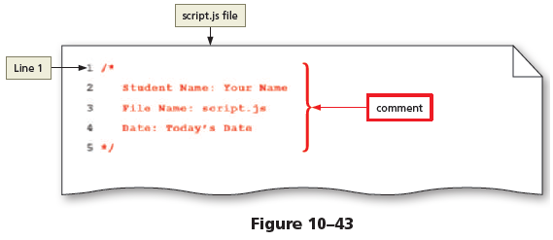
To Create a JavaScript File
On Line 1 of the script.js file, type /* to start a new comment.
Press the enter key to insert Line 2, increase the indent, and then type Student Name: and add your name.
Press the enter key to insert Line 3, and then type File Name: script.js to add the file name.
Press the enter key to insert Line 4, type Date: , and then type today’s date.
Press the enter key to insert Line 5, decrease the indent, and then type */ to close the comment (Figure 10–43).

Slide 76
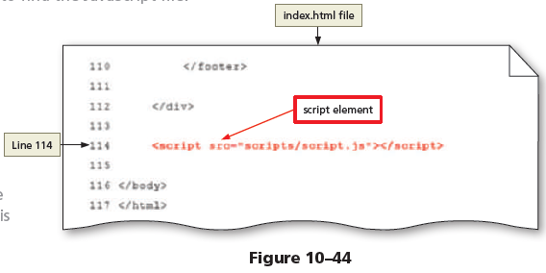

To Create a JavaScript File
Save your changes.
Open the index.html file in your text editor, tap or click at the end of Line 112, and then press the enter key twice to insert new Lines 113 and 114.
On Line 114, type <script src="scripts/script.js"></script> to insert a script element (Figure 10–44).

Slide 77
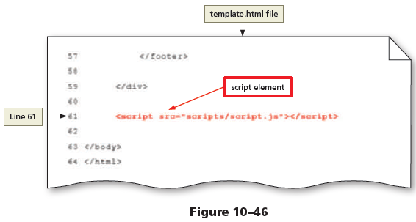
To Create a JavaScript File
Save your changes.
Open the classes.html file in your text editor, tap or click at the end of Line 145, and then press the enter key twice to insert new Lines 146 and 147.
On Line 147, type <script src="scripts/script.js"></script> to insert a script element.
Save your changes.
Open the nutrition.html file in your text editor, tap or click at the end of Line 112, and then press the enter key twice to insert new Lines 113 and 114.
On Line 114, type <script src="scripts/script.js"></script> to insert a script element.

Slide 78
To Create a JavaScript File
Save your changes.
Open the contact.html file in your text editor, tap or click at the end of Line 125, and then press the enter key twice to insert new Lines 126 and 127.
On Line 127, type <script src="scripts/script.js"></ script> to insert a script element.
Save your changes.
Open the template.html file in your text editor, tap or click at the end of Line 59, and then press the enter key twice to insert new Lines 60 and 61.
On Line 61, type <script src="scripts/script.js"></script> to insert a script element (Figure 10–46).

Slide 79
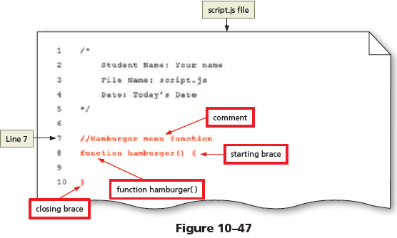
To Create the hamburger( ) Function
The hamburger menu is almost ready. You now need to create a JavaScript function to make the hamburger menu functional. Why? JavaScript programming is needed to display and hide the navigation links for a mobile viewport. Use the external JavaScript file, script.js, to write a function that displays the navigation links when the hamburger icon is selected. The following steps create the hamburger( ) function on the script.js file.
If necessary, reopen the script.js file in your text editor to prepare to modify it.
Tap or click at the end of Line 5, and then press the enter key twice to insert new Lines 6 and 7.
On Line 7, type //Hamburger menu function to insert a new, single-line comment.
Press the enter key, and then on Line 8, type function hamburger() { to begin a new function.
Press the enter key twice to insert new Lines 9 and 10.
On Line 10, type } to close the function (Figure 10–47).

Slide 80
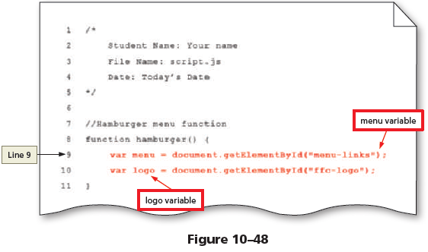
To Create the hamburger( ) Function
On Line 9, increase the indent, and then type var menu = document.getElementById("menu-links"); to define a local variable.
Press the enter key to insert a new Line 10, and then type var logo = document.getElementById("ffclogo"); to define another local variable (Figure 10–48).

Slide 81

To Create the hamburger( ) Function
Press the enter key to insert a new Line 11, and then type if (menu.style.display === "block" && logo.style.display === "none") { to insert an if statement.
Press the enter key to insert a new Line 12, increase the indent, and then type menu.style.display = "none"; to insert a statement.

Slide 82
To Create the hamburger( ) Function
Press the enter key to insert a new Line 13, and then type logo.style.display = "block"; to insert a statement.
Press the enter key to insert a new Line 14, decrease the indent, and then type } to close the if statement (Figure 10–49).

Slide 83

To Create the hamburger( ) Function
At the end of Line 14, press the spacebar to insert a space, and then type else { to insert an else statement.
Press the enter key to insert a new Line 15, increase the indent, and then type menu.style.display = "block"; to insert a statement.

Slide 84
To Create the hamburger( ) Function
Press the enter key to insert a new Line 16, and then type logo.style.display = "none"; to insert a statement.
Press the enter key to insert a new Line 17, decrease the indent, and then type } to close the else statement.
Save your changes (Figure 10–50).

Slide 85

To Call the hamburger( ) Function
Now that you have created the JavaScript function to make the hamburger menu functional, use an event to invoke, or call, the hamburger function. Why? JavaScript functions must be called in order to use them. Add an onclick event to the anchor element that contains the hamburger icon. Set the onclick event to call the hamburger function. The following steps add an onclick event to each HTML webpage.
1
If necessary, reopen the index.html file in your text editor to prepare to modify it.
Tap or click to the left of the closing angle bracket of the anchor tag on Line 28, and then type onclick="hamburger()" to add an onclick event.
Perform the same step for the about.html, classes.html, nutrition.html, contact.html, and template.html files.
Save all of your changes (Figure 10–51).

Slide 86

To Call the hamburger( ) Function
Open the index.html file in Google Chrome’s device mode and tap or click the Mobile – S 320px (gray) bar to view the page in a mobile viewport.
Tap or click the hamburger icon to display the navigation links (Figure 10–52).

Slide 87

To Call the hamburger( ) Function
Tap or click the hamburger icon to hide the navigation links (Figure 10–53).
Display each page within the website and test the hamburger icon on each page to ensure that it works on all pages within the website.

Slide 88


Styling Table Elements
After creating a table, style it by adding new style rules to the style sheet for the website. You can specify style rules for each table element. Table 8–2 lists common CSS properties and examples for styling tables.

Slide 89


Styling Table Elements
When a border is applied to table elements, by default, each cell has its own border, making the table appear to use double lines between each table data cell. This type of border is called a separated border. Figure 8–22 shows a table with the default border applied.
If you want to display a table with single, consolidated borders as shown in Figure 8–23, use the border-collapse property with a value of collapse. This type of border is called a collapsed border.

Slide 90
Styling Tables for Responsive Web Design
It can be difficult to style a table for a mobile viewport, especially when the table
consists of several columns. Many times, viewing a table requires extra horizontal and
vertical scrolling by the user. Other times, the table is so small that it is difficult to
read. Determine whether you can format the table so it is still easy to read in a mobile
viewport. If the table is too large or complex to format, you can display the content in a
different format such as a list or a chart in a mobile viewport.

Slide 91
To Style a Table for a Tablet Viewport
Create new style rules to style the table for the tablet viewport. Why? Format the table to clearly present its
information in a tablet viewport. First, create a style rule for the table element to specify borders, including
collapsed borders, to center the table on the page, and to set a width. Next, create a style rule for the caption
element and specify a font size, font color, and padding. Create a style rule for th and td elements to
specify borders and padding for the table header and data cells. Create a separate style rule for the th element
to format the table header with a dark background color and light font color. Finally, create a style rule to apply
a background color to every odd row within the table.
Add these new style rules to the end of the media query for the tablet layout so the rules will apply to webpages
displayed in a tablet viewport. The following steps create style rules for table elements in the tablet viewport.

Slide 92

To Add a New div Element to the Home Page
Open the styles.css file in your text editor to prepare to edit it.
Tap or click at the end of Line 286, and then press the enter key twice to insert new Lines 287 and 288.
On Line 288, type /* Tablet Viewport: Style rules for table */ to insert a new comment.
Press the enter key to insert a new Line 289, and then type table { to insert a new selector.
Press the enter key to insert a new Line 290, increase the indent, and then type border: 1px solid #000; to insert a new declaration.

Slide 93
To Add a New div Element to the Home Page
Press the enter key to insert a new Line 291, and then type border-collapse: collapse; to insert a new declaration.
Press the enter key to insert a new Line 292, and then type margin: 0 auto; to insert a new declaration.
Press the enter key to insert a new Line 293, and then type width: 100%; to insert a new declaration.
Press the enter key to insert a new Line 294, decrease the indent, and then type } to insert a closing brace (Figure 8–24).

Slide 94

To Add a New div Element to the Home Page
Save your changes and refresh classes.html in your browser (Figure 8–25).

Slide 95

To Add a New div Element to the Home Page
In the styles.css file, tap or click at the end of Line 294, if necessary, and then press the enter key twice to insert new Lines 295 and 296.
On Line 296, type caption { to insert a new selector.
Press the enter key to insert a new Line 297, increase the indent, and then type font-size: 1.5em; to insert a new declaration.

Slide 96
To Add a New div Element to the Home Page
Press the enter key to insert a new Line 298, and then type font-weight: bold; to insert a new declaration.
Press the enter key to insert a new Line 299, and then type padding: 1% to insert a new declaration.
Press the enter key to insert a new Line 300, decrease the indent, and then type } to insert a closing brace (Figure 8–26).

Slide 97

To Add a New div Element to the Home Page
Save your changes and refresh classes.html in your browser (Figure 8–27).

Slide 98

To Add a New div Element to the Home Page
In the styles.css file, tap or click at the end of Line 300, if necessary, and then press the enter key twice to insert new Lines 301 and 302.
On Line 302, type th, td { to insert two selectors.
Press the enter key to insert a new Line 303, increase the indent, and then type border: 1px solid #000; to insert a new declaration.
Press the enter key to insert a new Line 304, and then type padding: 2%; to insert a declaration.
Press the enter key to insert a new Line 305, decrease the indent, and then type } to insert a closing brace (Figure 8–28).

Slide 99

To Add a New div Element to the Home Page
Save your changes and refresh classes.html in your browser (Figure 8–29).

Slide 100

To Add a New div Element to the Home Page
In the styles.css file, tap or click at the end of Line 305, if necessary, and then press the enter key twice to insert new Lines 306 and 307.
On Line 307, type th { to insert a new selector.
Press the enter key to insert a new Line 308, increase the indent, and then type background-color: #000; to insert a new declaration.

Slide 101
To Add a New div Element to the Home Page
Press the enter key to insert a new Line 309, and then type color: #fff; to insert a new declaration.
Press the enter key to insert a new Line 310, and then type font-size: 1.15em; to insert a new declaration.
Press the enter key to insert a new Line 311, decrease the indent, and then type } to insert a closing brace (Figure 8–30).

Slide 102

To Add a New div Element to the Home Page
Save your changes and refresh classes.html in your browser (Figure 8–31).

Slide 103

To Add a New div Element to the Home Page
In the styles.css file, tap or click at the end of Line 311, if necessary, and then press the enter key twice to insert new Lines 312 and 313.
On Line 313, type tr:nth-child(odd) { to insert a new selector.
Press the enter key to insert a new Line 314, increase the indent, and then type background-color: #ccc; to insert a new declaration.
Press the enter key to insert a new Line 315, decrease the indent, and then type } to insert a closing brace (Figure 8–32).

Slide 104

To Add a New div Element to the Home Page
Save your changes and refresh classes.html in your browser (Figure 8–33).

Slide 105

To Style a Table for a Large Desktop Viewport
Create a new style rule to style the table for a large desktop viewport. Why? Format the table to restrict the width to 80 percent for a large desktop viewport. Add a new style rule to the large desktop media query to format the table width to 80 percent. The following steps create a new style rule for the large desktop viewport.
1
In the styles.css file, tap or click at the end of Line 398, and then press the enter key twice to insert new Lines 399 and 400.
On Line 400, type table { to insert a new selector.
Press the enter key to insert a new Line 401, increase the indent, and then type width: 80%; to insert a new declaration.
Press the enter key to insert a new Line 402, decrease the indent, and then type } to insert a closing brace (Figure 8–34).

Slide 106

To Style a Table for a Large Desktop Viewport
Save your changes, refresh classes.html in Google Chrome’s device mode, and set the viewport to 4K or a large viewport (Figure 8–35).

Slide 107

Creating Webpage Forms
Forms provide a structured way to collect information from webpage visitors, such as a visitor’s first name, last name, address, email, and telephone number. Visitors often complete webpage forms to register for an account or to make a purchase. Businesses use forms to gather visitor or customer information and store it in a database for future use. Figure 8–36 shows the Sign Up form on Facebook.com. Visitors complete the form to create a new Facebook account.

Slide 108
Form Controls
A form consists of a starting <form> tag and an ending </form> tag. All form elements are contained with the <form> and </form> tags. Input controls are used within the form element to collect visitor information. An input control is an interactive mechanism in which users enter text or make selections on a form. For example, on the Facebook Sign Up form, the text boxes requesting a visitor’s first name and last name are input controls. A label is text describing the type of information to enter with an input control. On the Facebook Sign Up form, “Birthday” is a label.
You define most controls in an HTML form by using the type attribute of the input element. For example, to add a text box to a form, you include an input element beginning with input type="text" in the form element in the HTML document. You define a few other controls using separate elements, such as the textarea and select elements.

Slide 109
Form Controls
Input controls can be classified as data or text input controls. A webpage visitor uses a data input control to make a selection or perform a command. A data input control can be a radio button (input type="radio"), a check box (input type="checkbox"), a Submit button (input type="submit"), a Reset button (input type="reset"), or a selection menu (select element). A text input control accepts text, such as names, dates, and passwords, and is often called an input field. Table 8–3 lists input types for an input control.
Regardless of the specific type, each input control has attributes that are used more frequently than the others:
name, which identifies the specific information that is being sent when the form is submitted for processing. All controls have a name.
id, which provides a unique ID for the element. Use the id attribute to link a label element with an input control or other form element.
value, which specifies the value of an input element and varies depending on input type. For text, password, and hidden controls, the value attribute defines the default value. For checkbox, radio, and image controls, it specifies the data submitted with the form when the control is selected. For button, reset, and submit controls, the value attribute defines the text on the button. All controls except textarea also have a value attribute. For a textarea field, no value attribute is possible because of the variability of the input.

Slide 110
Form Controls
Common input controls used with a form include text, password, email, tel, date, textarea, checkbox, radio, select, submit, and reset. Text input controls include the following types:
text box (text control), for small amounts of text
password text box (password control), for entering a password
email text box (email control), for entering an email address
telephone text box (tel control), for entering a telephone number
date text box (date control), for entering a date
text area box (textarea control), for larger amounts of text
Text, password, email, tel, and date controls accept a single line of text, such as a name or password. These text input controls have two frequently used attributes:
size, which determines the width of the control in characters
maxlength, which specifies the maximum number of characters accepted

Slide 111


Form Controls

Slide 112

Form Controls
the user’s username and the second line creates an eight-character text box for the user’s password:
<label> Username <input name="username" type="text" size="25"></label>
<label> Password <input name="password" type="password" size="8"></label>
Figure 8–37 shows an example of the code when rendered in a browser. Because each input element uses the size attribute, a user can enter a last name longer than 25 characters and a password longer than eight characters. If the input elements used the maxlength attribute instead of size, a user could only enter up to 25 characters for the username and up to eight characters for the password.

Slide 113
Form Controls
The maximum length of the text box may exceed the size of the text box that appears on the form. For example, consider a size of three characters and a maximum length of nine characters. If a webpage visitor enters more than three characters, the characters scroll to the left, allowing the visitor to enter a maximum of nine characters.
A password control is like a text control because it provides a text box for a single line of input—the password a visitor enters. However, as the visitor enters the password, the characters appear as asterisks or bullets, one per character. This feature helps protect the visitor’s password from being observed by others as it is entered.
An email control is a text box where visitors enter an email address. Some browsers validate that the email address is in the proper format before submitting the form for processing. If the email address is not in the proper format, the browser displays a message asking the user to correct the data. A tel control is a text box where visitors enter a telephone number. A date control is a text box that accepts a date.
Some browsers display a calendar when a visitor taps or clicks a date control.

Slide 114
Form Controls
A textarea control creates a text box that allows multiple lines of input.
Textarea controls are useful to collect more than a single line of text from a webpage visitor, such as a product review. To create a textarea control, you use the textarea element instead of the input element. The textarea element has two primary attributes, which set the size of the textarea control:
rows, which specifies the number of rows, or lines, in the textarea control
cols, which sets the width of the textarea control as the number of columns, with each column containing one character.
The following is an example of HTML code defining a textarea control:
<label>Please tell us more about your shopping experience with us today.</label>
<textarea name="feedback" rows="5" cols="100"></textarea>

Slide 115

Form Controls
Figure 8–38 shows an example of the label and textarea control when rendered in a browser. This textarea control provides five lines of 100 characters each to let visitors describe their shopping experience.

Slide 116
Form Controls
A checkbox control allows a webpage visitor to select items from a list of one or more choices. Each choice appears with a graphical box, which can be checked (selected or on) or unchecked (deselected or off). By default, all check boxes are deselected.
To set a particular check box to be preselected as the default, use the checked attribute and value (checked="checked") within the <input> tag. The following is sample code for four checkbox controls that might appear on a form for a college website where potential students select their career fields of interest.
<input type="checkbox" id="webdev" value="Web Development" name="field">
<label for="webdev">Web Development</label>
<input type="checkbox" id="program" value="Programming" name="field">
<label for="program">Programming</label>
<input type="checkbox" id="network" value="Networking" name="field">
<label for="network">Networking</label>
<input type="checkbox" id="appdev" value="Application Development" name="field">
<label for="appdev">Mobile App Development</label>

Slide 117

Form Controls
Figure 8–39 shows an example of the labels and checkbox controls when rendered in a browser. Users can select more than one item in a check box list. For example, a user could select both Web Development and Programming when selecting a field of interest from the website form.

Slide 118
Form Controls
A radio control limits the webpage visitor to only one choice from a list of choices. Each choice has a radio button, or option button, which typically appears as an open circle. When the visitor selects one of the radio buttons, all other radio buttons in the list are automatically deselected. By default, all radio buttons are deselected. To set a particular button as the default, you use the checked attribute and value within the <input> tag as you do with the checkbox control. The following example is similar to the previous checkbox control example, except it uses the radio controls on a website form:
<input type="radio" id="webdev" value="Web Development" name="field">
<label for="webdev">Web Development</label>
<input type="radio" id="program" value="Programming“ name="field">
<label for="program">Programming</label>
<input type="radio" id="network" value="Networking" name="field">
<label for="network">Networking</label>
<input type="radio" id="appdev" value="Application Development" name="field">
<label for="appdev">Mobile App Development</label>

Slide 119

Form Controls
Figure 8–40 shows an example of the labels and radio controls when rendered in a browser. A potential student will only be able to select one program of interest when using radio controls.

Slide 120
Form Controls
more choices. This prevents the visitor from having to type information into a text or textarea control. A select control is suitable when a limited number of choices are available. It appears on a form as a text box with a list arrow. The user taps or clicks the list arrow to view all the choices in the menu. The default choice appears first in the menu and is highlighted to indicate that it is selected.
Instead of using the type attribute of the input element, you define a select control using the select and option elements. The following is sample code for a select control:
<select name="referral">
<option>Advertisement</option>
<option>Friend</option>
<option>Google</option>
<option>Social Media</option>
</select>

Slide 121

Form Controls
Figure 8–41 shows an example of the select control when rendered in a browser. This selection menu contains four options—Advertisement, Friend, Google, and Social Media—with “Advertisement” appearing as the selected option.
The submit control and the reset control create the Submit and Reset buttons. The Submit button sends the form information to the appropriate location for processing. When a webpage visitor taps or clicks the Submit button on the form, the name of each control and the value of its data are sent to the server to be processed.

Slide 122
Form Controls
The Reset button clears any input entered in the form, resetting the input controls to their defaults. A webpage form must include a submit control, and must also include a reset control. You use the value attribute to specify the text that appears on the button. The submit and reset controls are created with the following code:
<input type="submit" value="Submit">
<input type="reset" value="Reset">

Slide 123

Form Controls
Some forms can be divided into various sections using a fieldset element, which is used to group related form elements. Each fieldset may include a legend, which is used as a caption for the fieldset. Figure 8–42 shows an example of a form that includes fieldsets, legends, and several input controls, including text, email, tel, checkbox, date, select, and textarea.

Slide 124
Form Labels
Form labels identify the type of information to enter into or select from an input control. You add a label to a form using the label element. To connect a label to its control, include the for attribute with the same value as the input control’s id value. The following code creates a label and a text box for a visitor’s first name:
<label for="fName">First Name:</label>
<input type="text" name="fName" id="fName">

Slide 125
Attributes of HTML Tags Used to Create Forms
Many of the HTML tags used to create forms have several attributes. Table 8–4 lists common form attributes, including several HTML 5 attributes for the input elements. However, many of these attributes are not supported by all major browsers, so be sure to test them first.

Slide 126

Attributes of HTML Tags Used to Create Forms

Slide 127

Attributes of HTML Tags Used to Create Forms

Slide 128

Attributes of HTML Tags Used to Create Forms

Slide 129
Form Processing
The post method sends a separate data file with the name-value pairs to the URL (or email address) indicated in the action attribute. The post method is the more common method because it can be used to send sensitive form data and does not have a size limitation. The following is an example of a form tag with the post method and specified action:
<form method="POST" action="formInfo.php">
Since form data processing involves web server and programming tasks that are beyond the scope of this book, the information entered in the form created in this chapter will not contain a method or an action attribute, and therefore, no data will be submitted to a web server or email address.

Slide 130
To Add a Form, Fieldset, Legend, Labels, and Text Input Controls to the Contact Us Page
Insert a form on the Contact Us page to collect information from prospective clients. Why? The Forward
Fitness Club wants to create a database of prospective clients and use it to market their services. Most of this client
data can come from the form on the Contact Us page. Start by including a new div element with a heading that alerts
visitors to the form. Add the starting <form> tag to the page, and then insert label elements and input text controls.
Finally, insert the ending </form> tag to complete the form. The following steps add a form to the Contact Us page.

Slide 131


To Add a Form, Fieldset, Legend, Labels, and Text Input Controls to the Contact Us Page
Open contact.html in your text editor to prepare to modify the document.
Tap or click at the end of Line 48 and press the enter key twice to insert new Lines 40 and 50.
On Line 50, type <div id="form"> to insert a new div tag.
Press the enter key twice to insert new Lines 51 and 52.
On Line 52, increase the indent, and then type <h2>Complete the form below to begin your free trial.</h2> to insert a heading 2 element.

Slide 132
To Add a Form, Fieldset, Legend, Labels, and Text Input Controls to the Contact Us Page
Press the enter key twice to insert new Lines 53 and 54, and then type <form class="form-grid"> <!-- Start Form --> to insert a starting form tag and a comment.
Press the enter key twice to insert new Lines 55 and 56.
On Line 56, increase the indent, and then type <fieldset> to insert a beginning fieldset tag.

Slide 133
To Add a Form, Fieldset, Legend, Labels, and Text Input Controls to the Contact Us Page
Press the enter key to insert a new Line 57, increase the indent, and then type <legend>Customer Information</legend> to insert a legend for the fieldset.
Press the enter key to insert a new Line 58, and then type <label for="fName">First Name:</label> to insert a label element.
Press the enter key to insert a new Line 59, and then type <input type="text" name="fName" id="fName" required> to insert an text input control (Figure 8–43).

Slide 134

To Add a Form, Fieldset, Legend, Labels, and Text Input Controls to the Contact Us Page
Press the enter key twice to insert new Lines 60 and 61, and then type <label for="lName">Last Name:</label> to insert a label element.
Press the enter key to insert a new Line 62, and then type <input type="text" name="lName" id="lName" required> to insert an text input control.
Press the enter key to insert a new Line 63, decrease the indent, and then type </fieldset> to insert an ending fieldset tag.
Press the enter key twice to insert new Lines 64 and 65, decrease the indent, and then type </form> to insert an ending form tag (Figure 8–44).

Slide 135

To Add a Form, Fieldset, Legend, Labels, and Text Input Controls to the Contact Us Page
Save your changes, open contact.html in your browser with a standard desktop viewport and scroll down if necessary to display the form (Figure 8–45).

Slide 136
To Add email and tel Input Controls to a Form
Add email and tel input controls to collect the customer’s email address and telephone number. Why?
Using these input controls instead of text controls makes it easier for visitors to enter the appropriate information.
First, add a new label and an input element with an email type. Then, add a new label and an input element
with a tel type. The following steps add email and tel input controls to the form on the Contact Us page.

Slide 137

To Add email and tel Input Controls to a Form
Tap or click at the end of Line 62 and press the enter key twice to insert new Lines 63 and 64.
On Line 64, type <label for="email">Email:</label> to insert a label element.
Press the enter key to insert a new Line 65, and then type <input type="email" name="email" id="email" required> to insert an email input control (Figure 8–46).

Slide 138

To Add email and tel Input Controls to a Form
Press the enter key twice to insert new Lines 66 and 67, and then type <label for="phone">Phone: </label> to insert a label element.
Press the enter key to insert a new Line 68, and then type <input type="tel" id="phone" name="phone" required> to insert a tel input control (Figure 8–47).

Slide 139

To Add email and tel Input Controls to a Form
Save your changes and refresh contact.html in your browser (Figure 8–48).

Slide 140
To Add Checkbox Controls to a Form
Add checkbox controls to collect information from customers about their primary interest in the fitness
club. Why? Using checkbox controls lets customers select more than one interest. First, add a new fieldset and legend
to group the new form elements together. Next, add a new paragraph element to introduce the checkbox controls.
Next, insert checkbox input elements nested within label elements. The following steps add checkbox controls to
the form on the Contact Us page.

Slide 141

To Add Checkbox Controls to a Form
Tap or click at the end of Line 69 and press the enter key twice to insert new Lines 70 and 71.
On Line 71, type <fieldset> to insert a starting fieldset tag.
Press the enter key to insert a new Line 72, increase the indent, and then type <legend>Additional Information</legend> to insert a legend element.

Slide 142
To Add Checkbox Controls to a Form
Press the enter key to insert a new Line 73, and then type <p>I would like more information about:</p> to insert a paragraph element.
Press the enter key twice to insert new Lines 74 and 75, and then type <label for="grpfit"><input type="checkbox" name="interest" id="grpfit" value="Group Fitness">Group Fitness</label> to insert a label element and a checkbox input element.

Slide 143
To Add Checkbox Controls to a Form
Press the enter key twice to insert new Lines 76 and 77, and then type <label for="prtrain"><input type="checkbox" name="interest" id="prtrain" value="Personal Training">Personal Training</label> to insert a label element and a checkbox input element.

Slide 144
To Add Checkbox Controls to a Form
Press the enter key twice to insert new Lines 78 and 79, and then type <label for="nutr"><input type="checkbox" name="interest" id="nutr" value="Nutrition">Nutrition</label> to insert a label element and a checkbox input element.
Press the enter key to insert a new Line 80, decrease the indent, and then type </fieldset> to insert a closing fieldset tag (Figure 8–49).

Slide 145

To Add Section Elements to the About Us Page
Save your changes and refresh contact.html in your browser (Figure 8–50).

Slide 146
To Add a select Element to a Form
Add a select element to learn how customers discovered the Forward Fitness Club. Why? A select
element lets users select from a list of options, restricting them to a valid option. First, add a new fieldset and legend
to group the new form elements together. Next, add a new label element for the referral source. Then, create a
select element with five option elements. The following steps add a select element to the form on
the Contact Us page.

Slide 147

To Add a select Element to a Form
Tap or click at the end of Line 80 and press the enter key twice to insert new Lines 81 and 82.
On Line 82, type <fieldset> to insert a new starting fieldset tag.
Press the enter key to insert a new Line 83, increase the indent, and then type <legend>Referral Source</ legend> to insert a legend element.
Press the enter key to insert a new Line 84 and then, type <label for="reference">How did you find us?</label> to insert a label element.

Slide 148
To Add a select Element to a Form
Press the enter key to insert a new Line 85, and then type <select name="reference" id="reference"> to insert a starting select tag.
Press the enter key to insert a new Line 86, increase the indent, and then type <option value="ad">Advertisement</option> to insert an option element.
Press the enter key to insert a new Line 87, and then type <option value="friend">Friend</option> to insert an option element (Figure 8–51).

Slide 149

To Add a select Element to a Form
Press the enter key to insert a new Line 88, and then type <option value="google">Google</option> to insert an option element.
Press the enter key to insert a new Line 89, and then type <option value="social">Social Media</option> to insert an option element.

Slide 150
To Add a select Element to a Form
Press the enter key to insert a new Line 90, and then type <option value="other">Other</option> to insert an option element.
Press the enter key to insert a new Line 91, decrease the indent, and then type </select> to insert a closing select tag.
Press the enter key to insert a new Line 92, decrease the indent, and then type </fieldset> to insert an ending fieldset tag (Figure 8–52).

Slide 151

To Add a select Element to a Form
Save your changes, refresh contact.html in your browser, and then tap or click the new select control (Figure 8–53).

Slide 152
To Add a textarea Element to a Form
Add a textarea element to the form to provide an opportunity for customers to ask questions. Why?
Customers can enter more than one line of text in a textarea control. The following steps add a label and a
textarea element to the form on the Contact Us page.

Slide 153

To Add a textarea Element to a Form
Save your changes and refresh ontact.html in your browser (Figure 8–55).

Slide 154
To Add a Submit Button to a Form
After adding text input controls and other form elements to a form, insert a submit control so that visitors
can submit the form with their responses. Why? Every form requires a submit control to send the information to a
web server for processing if specified. The following steps add a submit control to the form on the Contact Us page.

Slide 155

To Add a Submit Button to a Form
Tap or click at the end of Line 95 and press the enter key twice to insert new Lines 96 and 97.
On Line 97, type <input type="submit" id="submit" value ="Submit" class="btn"> to insert a submit input type (Figure 8–56).

Slide 156

To Add a Submit Button to a Form
Save your changes and refresh contact.html in your browser (Figure 8–57).

Slide 157
Styling Forms
You apply CSS styles to forms for the same reason you style other webpage elements: to improve the appeal and usefulness of the form and its controls. For example, you position labels and form controls so users can quickly and clearly understand what type of information to provide in each control. As with tables, consider forms in the context of responsive design. Start with a simple, basic form for the mobile viewport. This form requests only the most essential information. You can modify the appearance and the content of the form for the tablet and desktop viewports. For example, you can change a form that is long and narrow in a mobile viewport so it is wider and arranges controls in columns in a desktop viewport. You can also include controls to collect optional information, such as product feedback, in tablet and desktop viewports.

Slide 158
To Style a Form for a Mobile Viewport
Now that the form is complete, you can style the form for a mobile viewport. First, create a style rule for
the form div to set some top margin, specify a background color, and set some padding. Next, create a style rule
to center-align the heading 2 element within the form div. Create a style rule that sets the bottom margin for
the fieldsets and controls. Why? To avoid horizontal scrolling, display the form elements as blocks so that each
element appears on its own line. Create another style rule to format the fieldset legend elements. Create another
style rule to display the label elements as a block and add some top padding. The following steps create style rules
for form elements in a mobile viewport.

Slide 159

To Style a Form for a Mobile Viewport
Open styles.css to prepare to modify it.
Tap or click at the end of Line 184 and press the enter key twice to insert new Lines 185 and 186.
On Line 186, type #form { to add a new selector.
Press the enter key to insert a new Line 187, increase the indent, and then type margin-top: 2%; to insert a declaration.
Press the enter key to insert a new Line 188, and then type background-color: #f2f2f2; to insert a declaration.
Press the enter key to insert a new Line 189 and then type padding: 2%; to insert a declaration.

Slide 160
To Style a Form for a Mobile Viewport
Press the enter key to insert a new Line 190, decrease the indent, and then type } to insert a closing brace.
Press the enter key twice to insert new Lines 191 and 192.
On Line 192, type #form h2 { to add a new selector.
Press the enter key to insert a new Line 193, increase the indent, and then type text-align: center; to insert a declaration.
Press the enter key to insert a new Line 194, decrease the indent, and then type } to insert a closing brace (Figure 8–58).

Slide 161

To Style a Form for a Mobile Viewport
Press the enter key twice to insert new Lines 195 and 196.
On Line 196, type /* Style rules for form elements */ to insert a comment.
Press the enter key to insert a new 197, and then type fieldset, input, select, textarea { to add a new selector.
Press the enter key to insert a new Line 198, increase the indent, and then type margin-bottom: 2%; to insert a declaration.
Press the enter key to insert a new Line 199, decrease the indent, and then type } to insert a closing brace (Figure 8–59).

Slide 162

To Style a Form for a Mobile Viewport
Press the enter key twice to insert new Lines 200 and 201.
On Line 201, type fieldset legend { to insert a new selector.
Press the enter key to insert a new Line 202, increase the indent, and then type font-weight: bold; to insert a declaration.
Press the enter key to insert a new Line 203, and then type font-size: 1.25em; to insert a new declaration.
Press the enter key to insert a new Line 204, decrease the indent, and then type } to insert a closing brace.

Slide 163
To Style a Form for a Mobile Viewport
Press the enter key twice to insert new Lines 205 and 206.
On Line 206, type label { to insert a new selector.
Press the enter key to insert a new Line 207, increase the indent, and then type display: block; to insert a declaration.
Press the enter key to insert a new Line 208, and then type padding-top: 3%; to insert a declaration.
Press the enter key to insert a new Line 209, decrease the indent, and then type } to insert a closing brace (Figure 8–60).

Slide 164

To Style a Form for a Mobile Viewport
Press the enter key twice to insert new Lines 210 and 211.
On Line 211, type form #submit { to insert a new selector.
Press the enter key to insert a new Line 212, increase the indent, and then type margin: 0 auto; to insert a declaration.
Press the enter key to insert a new Line 213, and then type border: none; to insert a declaration.
Press the enter key to insert a new Line 214, and then type display: block; to insert a declaration.

Slide 165
To Style a Form for a Mobile Viewport
Press the enter key to insert a new Line 215, and then type padding: 2%; to insert a declaration.
Press the enter key to insert a new Line 216, and then type background-color: #b3b3b3; to insert a declaration.
Press the enter key to insert a new Line 217, and then type font-size: 1em; to insert a declaration.
Press the enter key to insert a new Line 218, and then type border-radius: 10px; to insert a declaration.
Press the enter key to insert a new Line 219, decrease the indent, and then type } to insert a closing brace (Figure 8–61).

Slide 166


To Style a Form for a Mobile Viewport
Save your changes, open contact.html in Google Chrome's device mode, select the mobile viewport, and then scroll down to view the form. (Figure 8–62).

Slide 167
To Style a Form for a Tablet Viewport
Now that you have styled the form for a mobile viewport, you can also style the form for a tablet viewport.
Why? The current styles work best for the form in a mobile viewport. Optimize the form for the best viewing
experience by a tablet user. In the tablet media query, create a style rule for the form element that sets the width to
70 percent and centers the form on the page. The following steps create new style rules for the form element within
the tablet media query of the styles.css file.

Slide 168

To Style a Form for a Tablet Viewport
In the styles.css file, tap or click at the end of Line 350 and press the enter key twice to insert new Lines 351 and 352.
On Line 352, type /* Tablet Viewport: Style rule for form element */ to add a comment.
Press the enter key to insert a new Line 353, and then type form { to add a new selector.

Slide 169
To Style a Form for a Tablet Viewport
Press the enter key to insert a new Line 354, increase the indent, and then type width: 70%; to insert a declaration.
Press the enter key to insert a new Line 355, and then type margin: 0 auto; to insert a declaration.
Press the enter key to insert a new Line 356, decrease the indent, and then type } to insert a closing brace (Figure 8–63).

Slide 170

To Style a Form for a Tablet Viewport
Save your changes, refresh contact.html in your browser, and select the tablet viewport, and then scroll down if necessary to view the changes (Figure 8–64).

Slide 171
To Style a Form for a Desktop Viewport
Now that you have styled the form for a mobile and tablet viewports, you can style the form for a desktop
viewport. Why? The desktop viewport provides more space to modify the form layout to use to three columns. First,
create a style rule that sets the form width to auto. Next, create a style rule for the form-grid class selector that sets
the display to a grid with three columns and sets the grid gap to 20px. Finally, create a style rule for the btn class
selector that spans the Submit button across the three columns. The following steps create style rules for a form
elements within the desktop media query of the styles.css file.

Slide 172

To Style a Form for a Desktop Viewport
Tap or click at the end of Line 429 and press the enter key twice to insert new Lines 430 and 431.
On Line 431, type /* Desktop Viewport: Style rules for form elements */ to add a comment.
Press the enter key to insert a new Line 432, and then type form { to add a new selector.
Press the enter key to insert a new Line 433, increase the indent, and then type width: auto; to insert a declaration.
Press the enter key to insert a new Line 434, decrease the indent, and then type } to insert a closing brace.

Slide 173
To Style a Form for a Desktop Viewport
Press the enter key twice to insert new Lines 435 and 436.
On Line 436, type .form-grid { to add a new selector.
Press the enter key to insert a new Line 437, increase the indent, and then type display: grid; to insert a declaration.
Press the enter key to insert a new Line 438, and then type grid-template-columns: auto auto auto; to insert a declaration.
Press the enter key to insert a new Line 439, and then type grid-gap: 20px; to insert a declaration.).

Slide 174
To Style a Form for a Desktop Viewport
Press the enter key to insert a new Line 440, decrease the indent, and then type } to insert a closing brace.
Press the enter key twice to insert new Lines 441 and 442.
On Line 442, type .btn { to insert a new selector.
Press the enter key to insert a new Line 443, increase the indent, and then type grid-column: 1 / span 3; to insert a declaration.
Press the enter key to insert a new Line 444, decrease the indent, and then type } to insert a closing brace (Figure 8–65).

Slide 175

To Style the Nutrition Page for a Desktop Viewport
Save your changes, refresh contact.html in your browser, and display the webpage in a desktop viewport (Figure 8–66).

Slide 176
To Validate the Style Sheet
Always run your files through W3C’s validator to check the document for errors. If the document has any errors, validating gives you a chance to identify and correct them. Validation is also an effective troubleshooting tool during the development process and adds a valuable level of professionalism to your work. The following steps validate a CSS document:
Open your browser and type http://jigsaw.w3.org/css-validator/ in the address bar to display the W3C CSS Validation Service page.
Tap or click the By file upload tab to display the Validate by file upload information.
Tap or click the Browse button to display the Choose File to Upload dialog box.
Navigate to your css folder to find the styles.css file.
Tap or click the styles.css document to select it.
Tap or click the Open button to upload the selected file to the W3C CSS validator.
Tap or click the Check button to send the document through the validator and display the validation results page.
If necessary, correct any errors, save your changes, and run through the validator again to revalidate the page.

Slide 177
To Validate the HTML Files
Every time you create a new webpage or modify an existing webpage, run it through W3C’s validator to check the document for errors. If any errors exist, you need to correct them. Validation is also an effective troubleshooting tool during the development process and adds a valuable level of professionalism to your work. The following steps validate an HTML document.
Open your browser and type http://validator.w3.org/ in the address bar to display the W3C validator page.
Tap or click the Validate by File Upload tab to display the Validate by File Upload information.
Tap or click the Choose File button to display the Open dialog box.
Navigate to your fitness folder to find the classes.html file.
Tap or click the classes.html document to select it.
Tap or click the Open button to upload it to the W3C validator.
Tap or click the Check button to send the document through the validator and display the validation results page.
If necessary, correct any errors, save your changes, and run through the validator again to revalidate the page.
Follow these steps to validate the contact.html page and correct any errors.

Slide 178
Summary
In this chapter, you learned how to include tables and forms on webpages. You created a table that displays
related information and then formatted it using CSS properties you have used before and one new property
specific to tables. You also learned about webpage forms and form controls, including the HTML elements,
attributes, and values for creating the controls you need. Finally, you used CSS styles to format a form for
mobile, tablet, and desktop viewports. The items listed below include all the new skills you have learned in this
chapter, with the tasks grouped by activity.

Slide 179
Summary
Discovering Tables
Add a Table to the Classes Page (HTML 411)
Styling Table Elements
Style a Table for a Tablet Viewport (HTML 417)
Style a Table for a Large Desktop Viewport
(HTML 422)
Creating Webpage Forms
Add a Form and Form Controls to the Contact Us
Page (HTML 432)
Add email and tel Input Controls to a Form
(HTML 433)
Add Checkbox Controls to a Form (HTML 434)
Add a select Element to a Form (HTML 435)
Add a textarea Element to a Form (HTML 437)
dd Submit Button to a Form (HTML 438)
Styling Forms
Style a Form for a Mobile Viewport (HTML 439)
Style a Form for a Tablet Viewport (HTML 442)
Style a Form for a Desktop Viewport (HTML 443)

